Slide 1


SEO Navigator: From Audit to Action
Zoho Corporation Pvt. Ltd.
By
T. Kavitha Jayendran
GUVI CAPSTONE PROJECT 2026

Slide 2
Project Overview
Project Objective
  Conduct a comprehensive SEO audit of Zoho's website.
  Evaluate Technical, On-Page and Off-Page SEO.
  Perform Keyword Research and Competitor Analysis.
  Develop Content Strategy.
  Recommend SEO improvements.
Scope
  Website Audit
  SEO Analysis
  Keyword Research
  Competitor Analysis
  Content Strategy
  SEO Recommendations

Slide 3
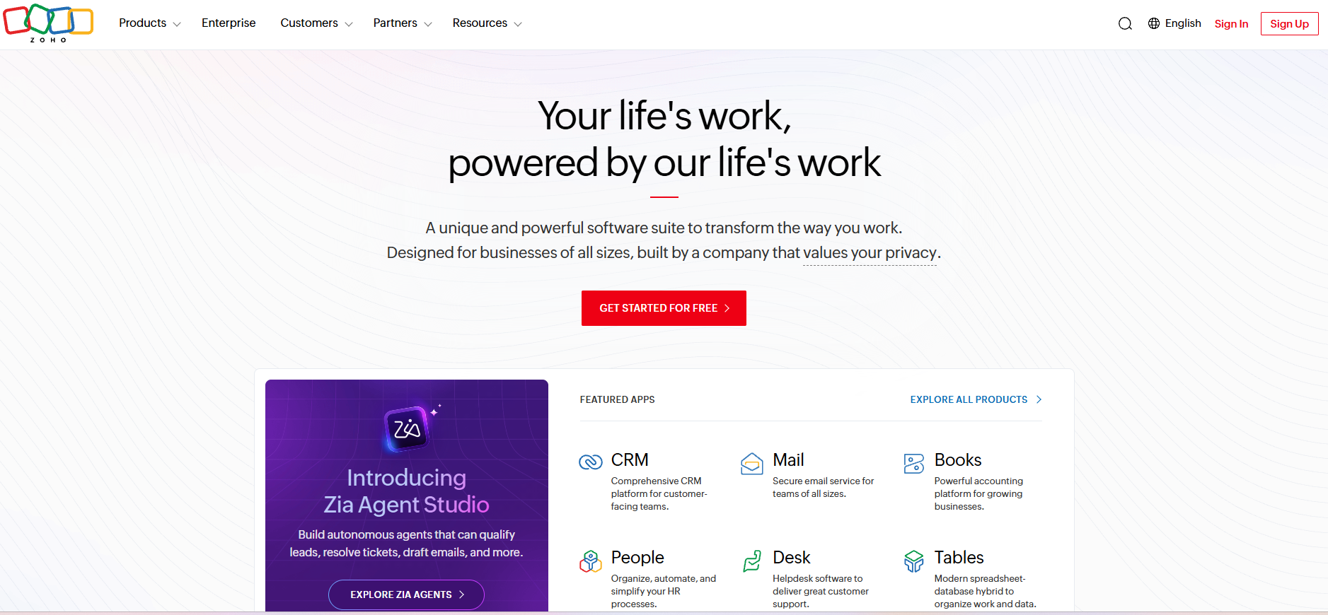
Company Profile
Item | Details
Company | Zoho Corporation Pvt. Ltd.
Industry | SaaS
Founded | 1996
Headquarters | Chennai
Products | CRM, Books, Mail, Projects, People, Desk
Why Zoho?
  Global SaaS leader
  Strong SEO
  Excellent website
  User-friendly interface
Website: www.zoho.com

Slide 4

Initial SEO Audit
Key Findings
  Excellent Accessibility
  Strong SEO
  Responsive Design
  Desktop Core Web Vitals Passed
  Mobile Performance can improve
Metric | Mobile | Desktop
Performance | 71 | 66
Accessibility | 96 | 100
Best Practices | 73 | 73
SEO | 92 | 92

Slide 5
Technical SEO Analysis
Strengths
  🔒 HTTPS
  🗺 XML Sitemap
  🤖 Robots.txt
  📱 Mobile Friendly
  ✅ Crawlability
Issues
  ⚠ Large Images
  ⚠ Heavy JavaScript
  ⚠ Render Blocking Resources
  ⚠ Mobile Performance
Metric | Score
Performance | 66
Accessibility | 100
Best Practices | 73
SEO | 92

Slide 6
On-Page & Off-Page SEO
On-Page SEO
  Optimized Titles
  Meta Description
  Heading Structure
  Internal Linking
  SEO Friendly URLs
Off-Page SEO
  Strong Domain Authority
  Quality Backlinks
  Active Social Media
  Excellent Brand Reputation

Slide 7




SWOT Analysis
STRENGTHS
Strong SEO
Accessibility
HTTPS
Responsive Design
WEAKNESSES
Mobile Speed
Heavy JS
Large Images
OPPORTUNITIES
AI Content
Long-tail Keywords
Core Web Vitals
THREATS
Salesforce
HubSpot
Google Updates

Slide 8

Keyword Research
Products
  Zoho CRM
  Zoho Books
Intent | Count
Informational | 7
Navigational | 2
Transactional | 11
Key Observation
Balanced keyword strategy covering all stages of the customer journey.

Slide 9

Competitor Analysis
Zoho | Salesforce | HubSpot | QuickBooks
SEO | Excellent | Excellent | Excellent
Blog | Extensive | Extensive | Very Extensive
Free Trial | Yes | Yes | Yes
Major Competitors
  Salesforce
  HubSpot
  Microsoft Dynamics 365
  QuickBooks
  Xero
  FreshBooks

Slide 10


Content Strategy
Content Plan
  Weekly Blogs
  Product Tutorials
  Case Studies
  Webinars
  Comparison Articles
Target Audience
Small Businesses
Startups
Sales Teams
Finance Professionals

Slide 11




SEO Strategy & Recommendations
On-Page
Improve Meta Tags
Better Internal Links
Content
Long-tail Keywords
Product Comparisons
Tutorials
Technical
Compress Images
Reduce JS
Improve Core Web Vitals
Off-Page
Backlinks
Guest Posting
Social Media

Slide 12

Conclusion
Key Takeaways
  Strong SEO foundation
  Excellent accessibility
  Good website architecture
  Opportunities to improve mobile performance
  Effective keyword and content strategy
  Continuous SEO optimization will improve rankings and organic traffic

